Slide 1


Athletics 2026-27 Family Meeting
Aug 19, 2026
Brett Sniffin
bsniffin@durangoschools.org
Tana Creek
tcreek@durangoschools.org
Ryan Knorr
rknorr@durangoschools.org
Athletics Dept Phone: 970-259-1630x2302
durangoathletics.com

Slide 2
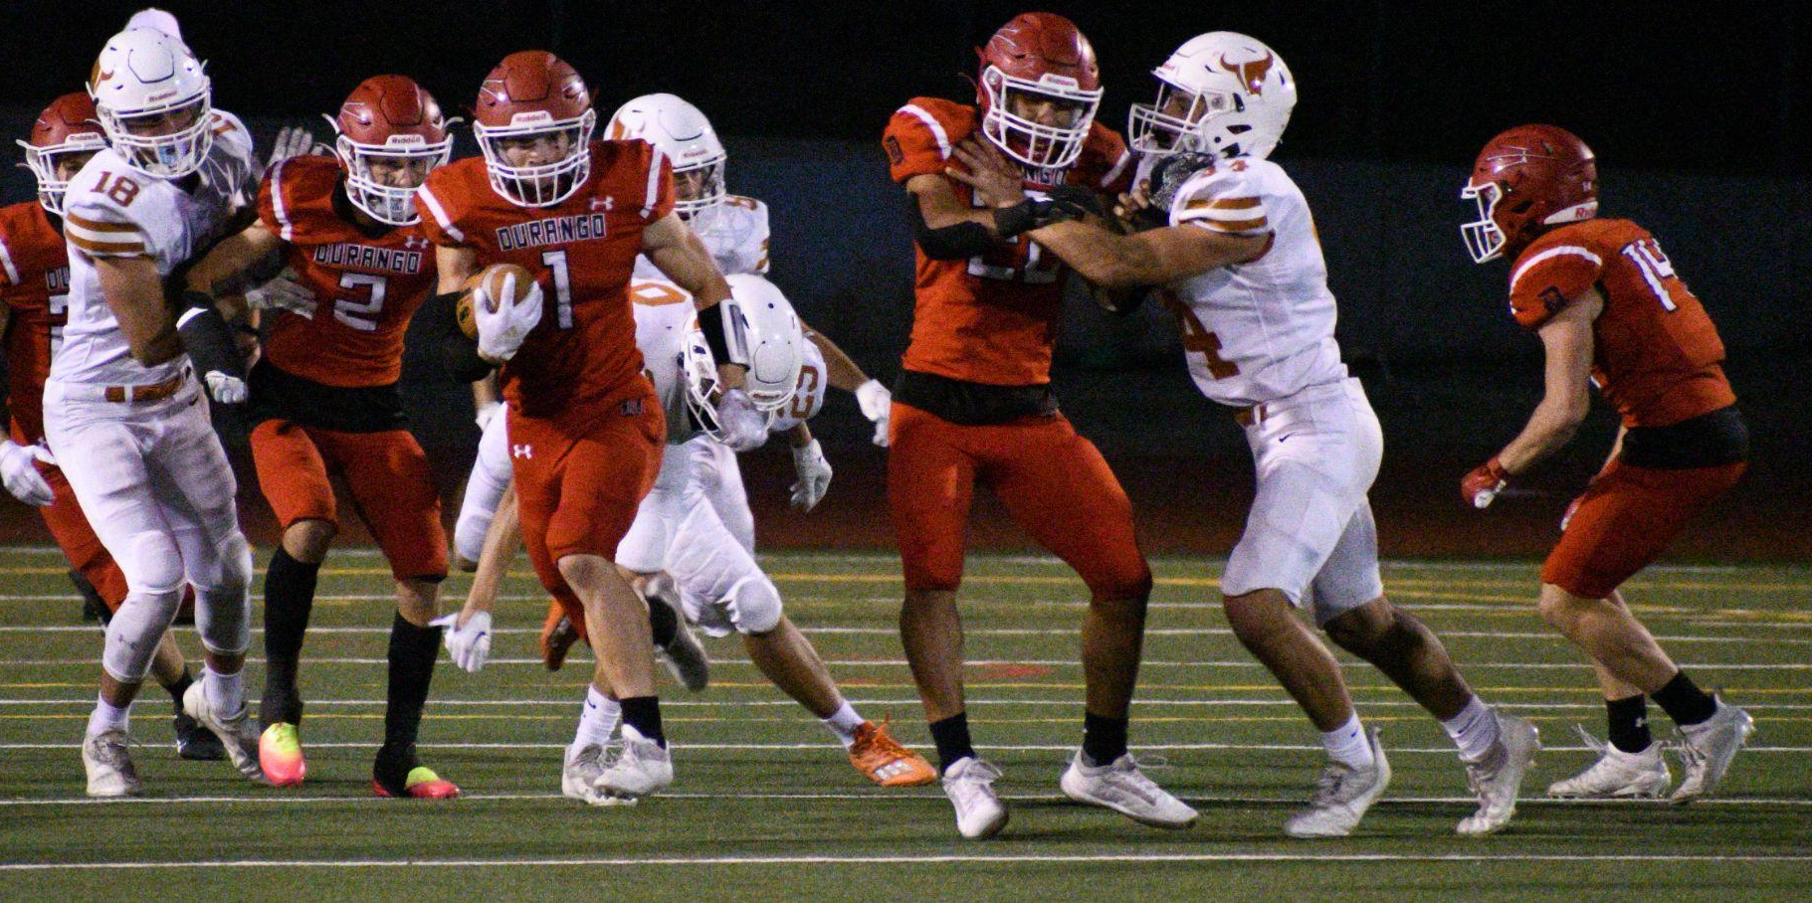
Department Philosophy
Students leave our programs as better individuals in and out of competition. Support growth to meet their potential while striving to be the best in the state of Colorado.

Slide 3
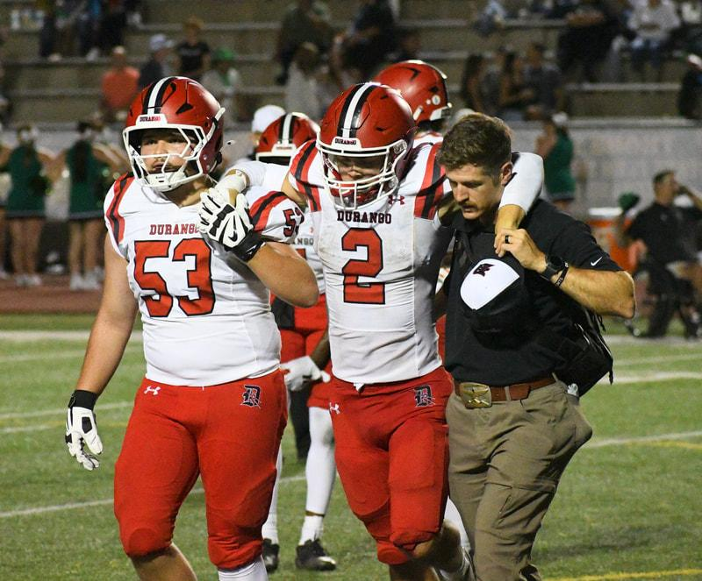
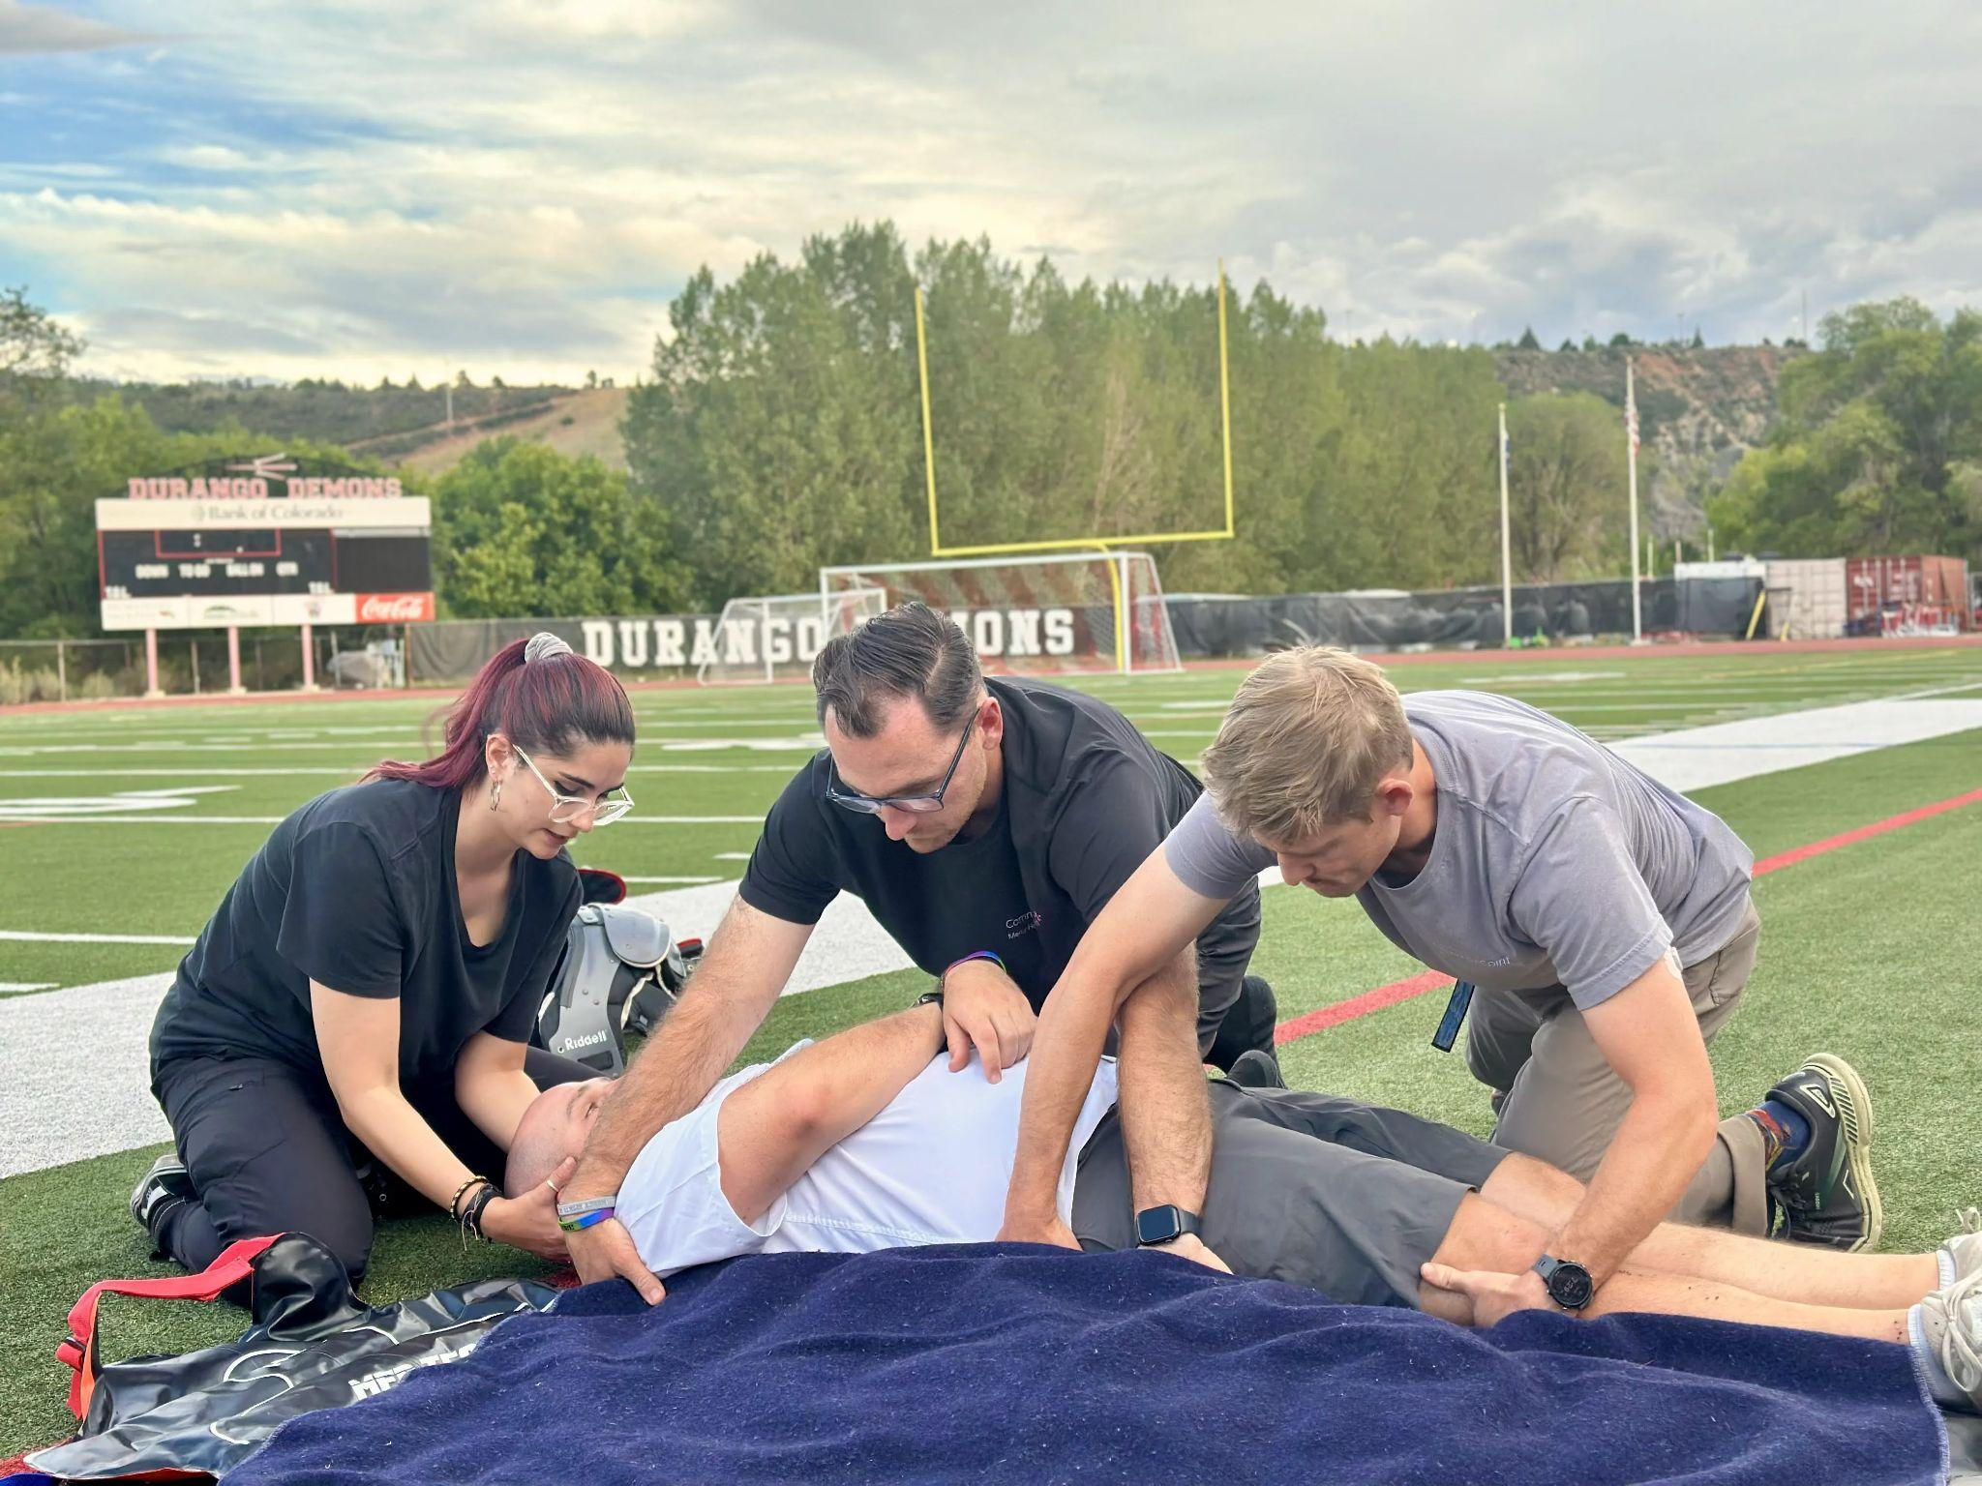
Safety
ATs at the High School
Robert Marks, MBATS, LAT, ATC robert.marks900@commonspirit.org
Avery Koski, MSAT, LAT, ATC
avery.koski@commonspirit.org

Slide 4
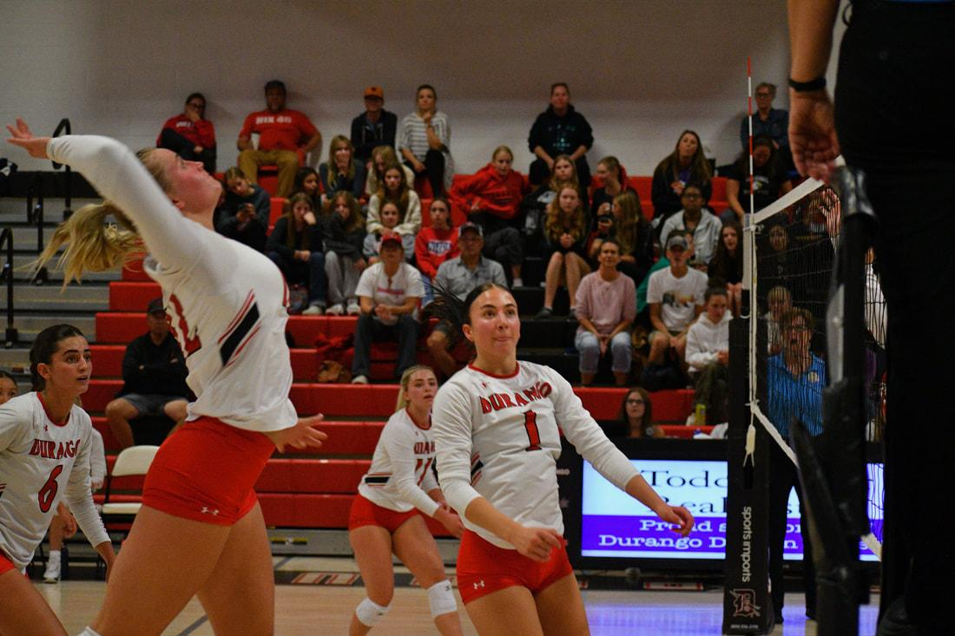
ATs - Concussions
Student education/awareness
Any doubt, any observation of impact - AT evaluates (at practice, home game, away game) - Error on the side of caution (State law)
Sway Testing
Concussion protocol - teacher - parent communication
Return to Play - dictated by AT, Doc note required, process

Slide 5
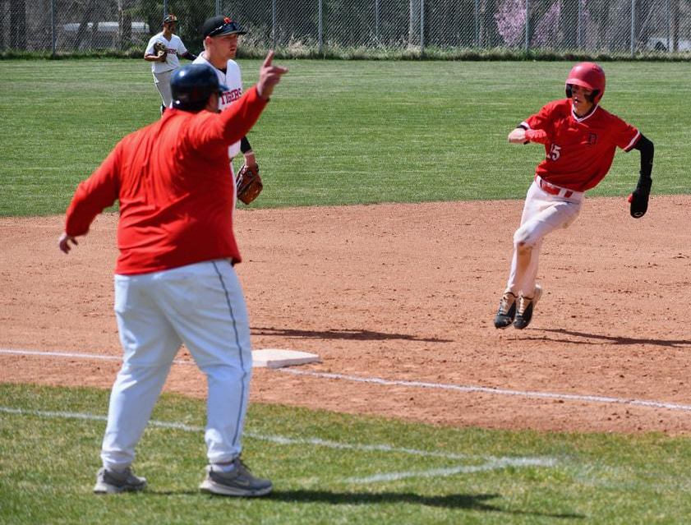
ATs - Process & Communication
Healthy Roster
If a parent wants to challenge an assessment
Doctors notes required to return from concussion
Over communicate & collaborate

Slide 6
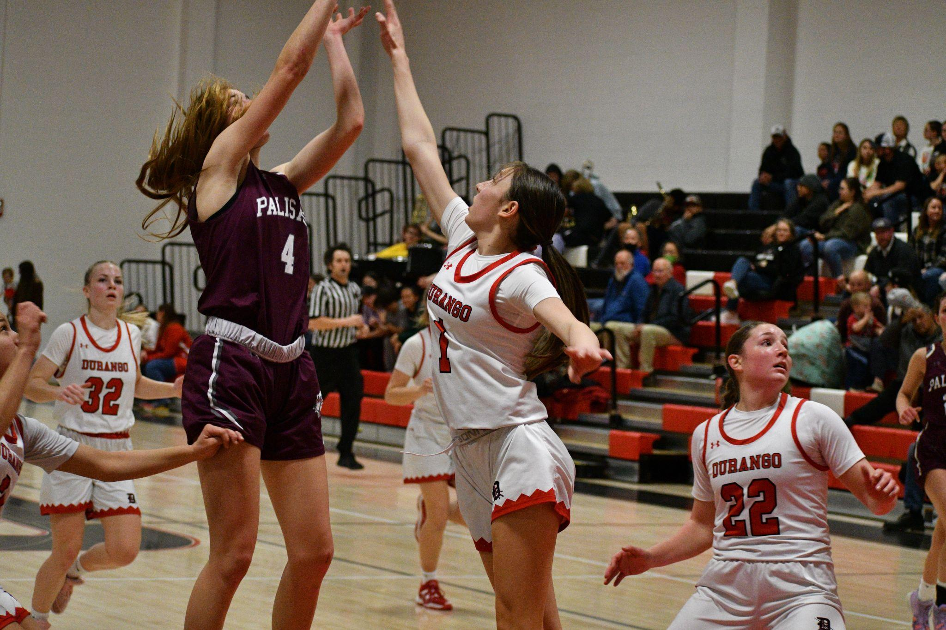
Mental Health & Character Building
Mental Health - Communication, check-ins, safety Plans
Do the right thing always or you won’t when it is crunch time
Inclusion, Life Lessons, emphasis on treating everyone with respect
Teachable Moments are always opportunities - you’re either addressing it or allowing it
No Place for Hate - Consequences and investigations on reports of Bullying, Hazing, Harassment, Discrimination
Impactful coaching lasts a lifetime - not just in a season

Slide 7

Mental Coaching - Sports Psychologist
"Every parent's seen it. Weeks of hard work, then competition day comes and something falls apart — nerves take over, or one bad game/race erases their confidence. Nobody really tells you what to do with that.
I'm Dr. Josh Coon. Doctoral-level sport psychologist and a nationally certified counselor — the only one in Durango with that combination. Ten years coaching NCAA athletes before I did this full time, and now I work with pro and elite endurance athletes (Olympians and US Record holders) on these exact problems.
I don't replace your coach. I work alongside them, directly with your athlete, on the mental skills that hold up when it counts — and if what's going on is bigger than sports, the counseling background means I can help with that too.
If your athlete's ready to compete with a clear head instead of a knot in their stomach, let's talk."
Josh Coon
joshua@shift-psych.com

Slide 8
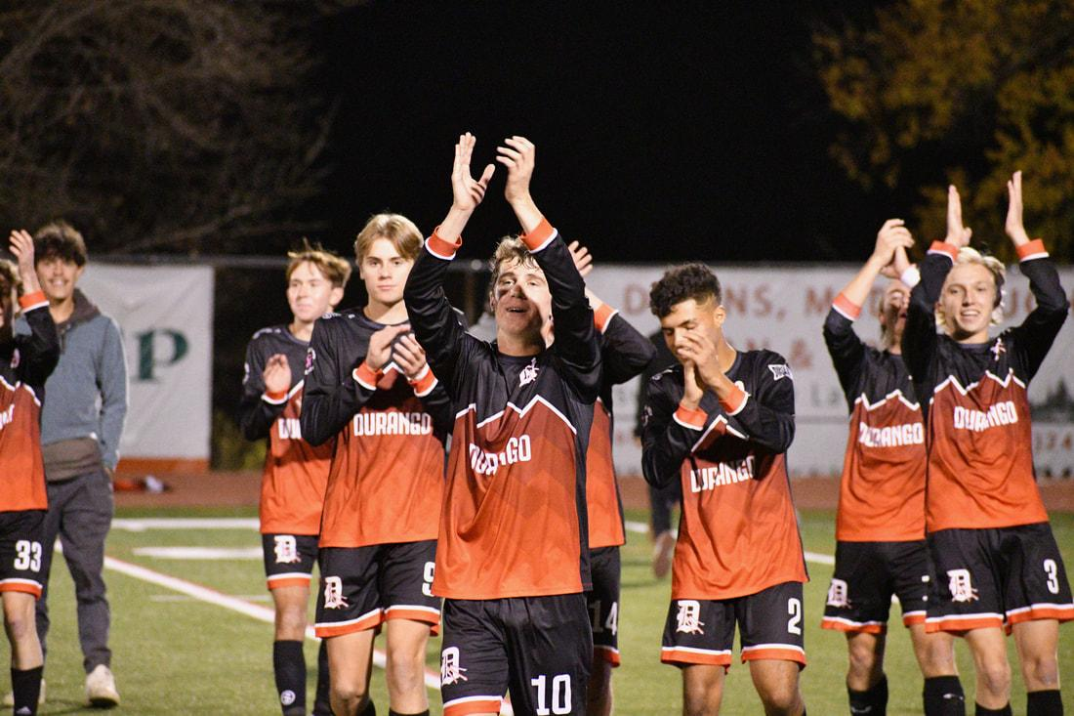
Code of Conduct
Link to Code of Conduct
365, 7 days a week, on or off school campus - high expectations for athletes and representing more than just themselves
Signed off on during registration
Suspendable consequences are at least 1 loss of contest
Social Media uptick - screen shots are real

Slide 9
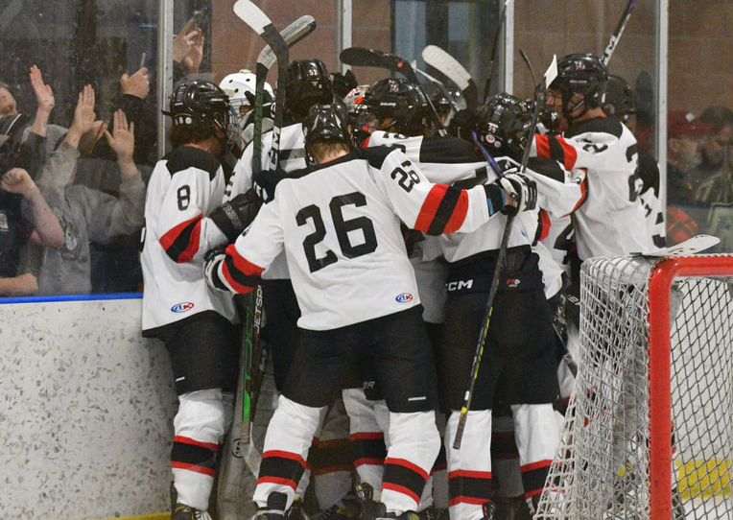
Required Player Parent Handbook
Customized for each team, but lots of department expectations
Parent/Guardian & player required Signature and return
Won’t issue uniform until it’s signed and returned
High expectations - participation is a privilege
Schedules and contact information should be as clear as possible

Slide 10
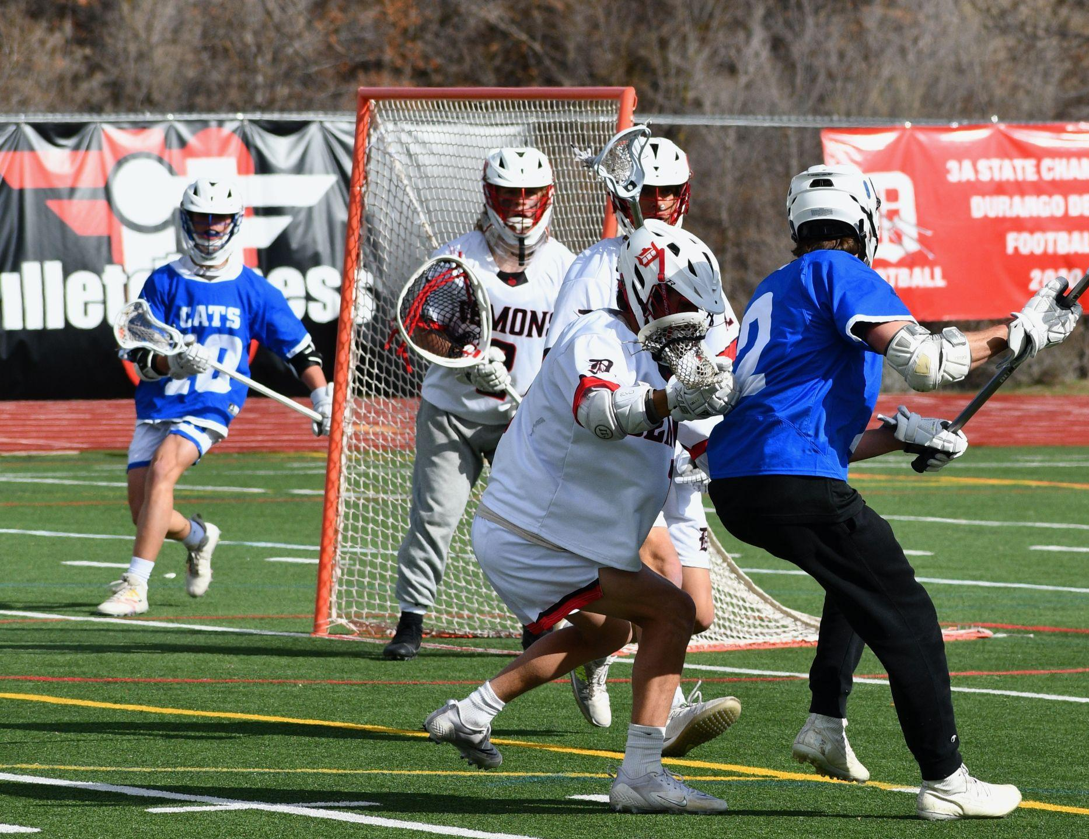
Student Clearance
Registration & Sports Physical on file to participate
Payment & signed handbook prior to uniform handout
Link to Registration Site

Slide 11
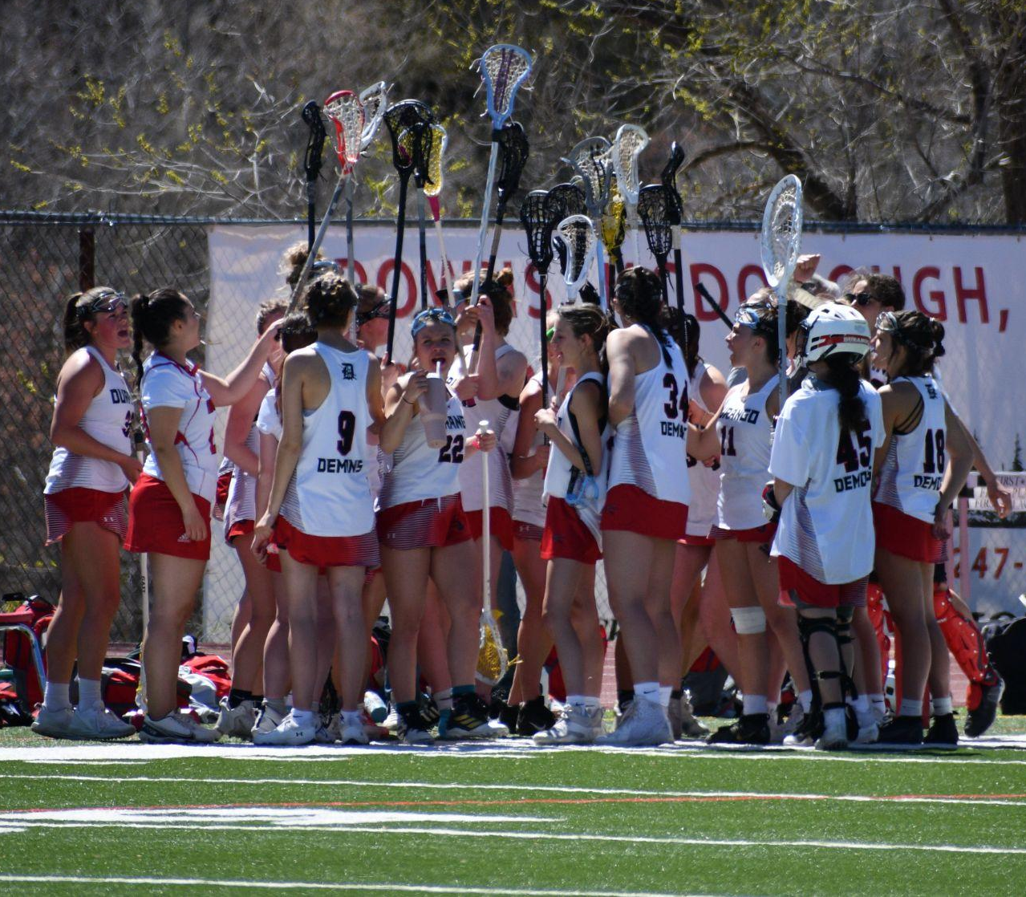
Eligibility
Semester Eligibility - can regain halfway through the season
Code of Conduct - behavior
Transfer Students
5 credited classes per semester
Weekly Eligibility (next slide)
Attendance - 4 or more unexcused
Can’t travel with a D (must come up 24 hours prior)
Ultimately students responsibility; do not submit assignments late if possible
Families, check grades early and often
Late Work policy if they miss for athletics

Slide 12
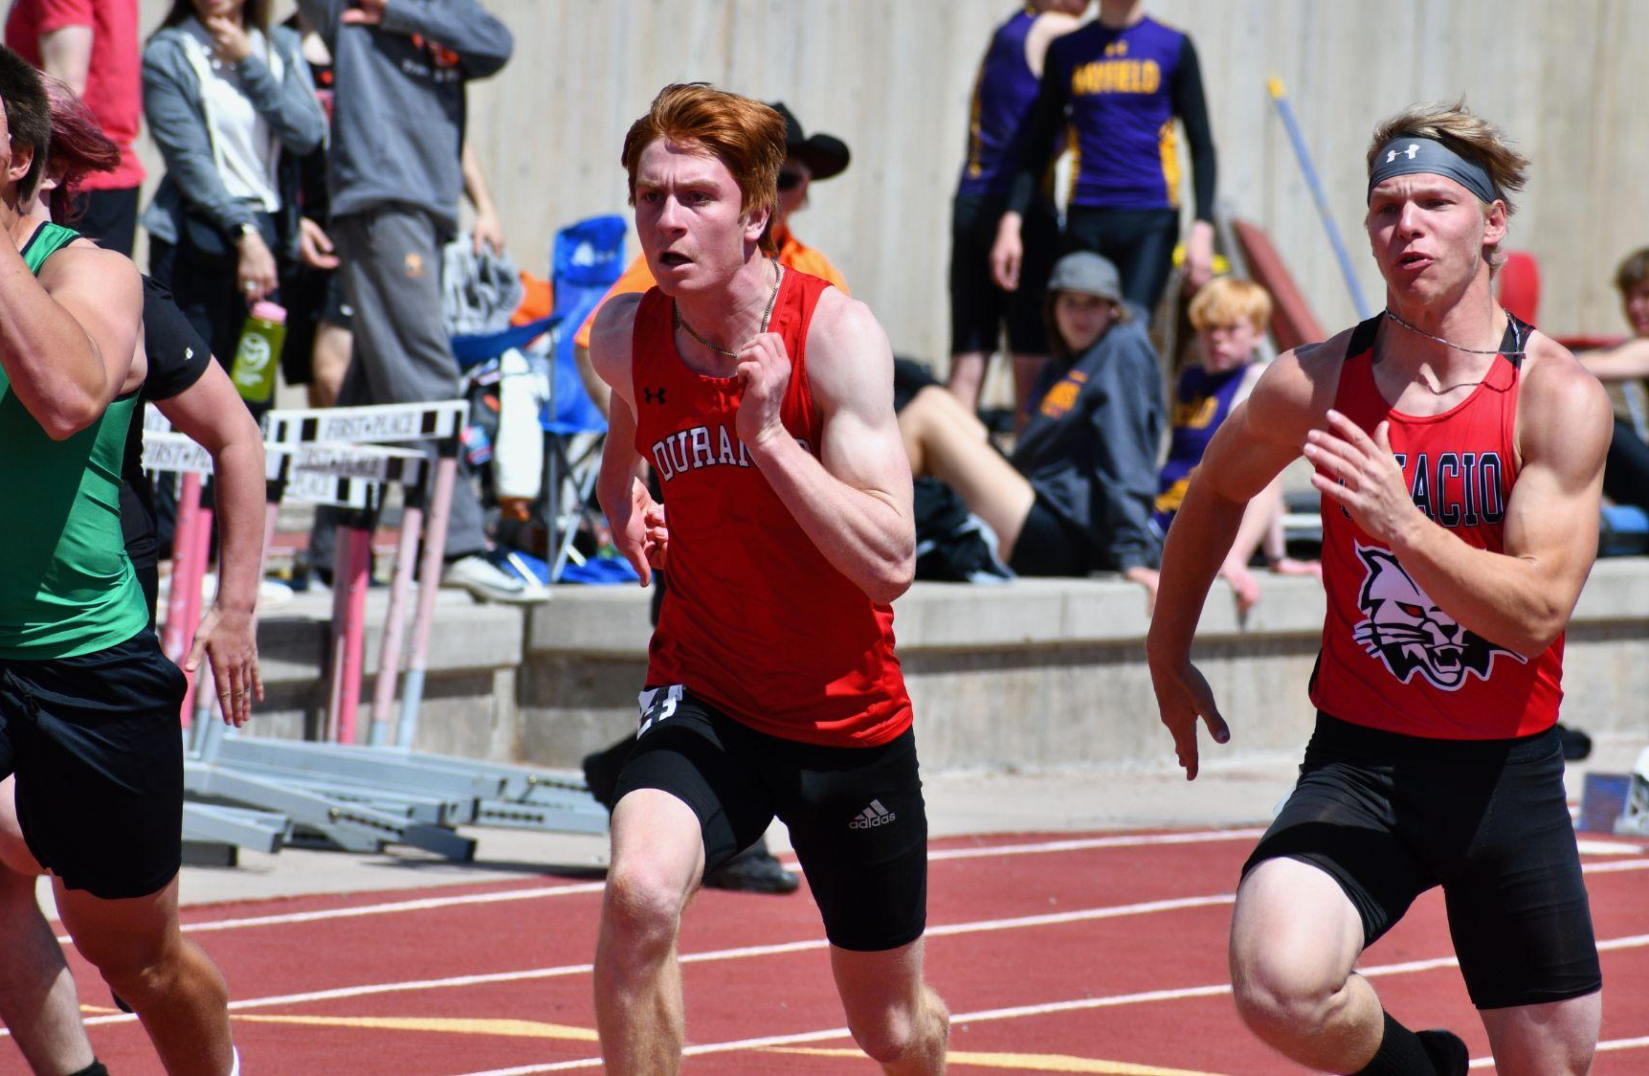
Eligibility Continued
Weekly eligibility - 1 F or more - one week week of ineligibility (Thur-Wed); locked in for CHSAA record at Thursday at 10am for one week
Pulled Tuesday afternoon; communicated to students that evening - IC must reflect by Thursday 10am for final grade pull.
4 or more unexcused absences - ineligible Thur-Wed (must be cleared up 24 hours prior)
Do not pressure teachers to change grades; empower students to take responsibility and have conversations around assignments/grades

Slide 13
Parent Expectations
Let the coaches coach
Positive communication during competition with coaches, officials, other parents, other teams/athletes
Support your athletes communicating/advocating with the coach
24 hour communication rule with coach following competition
Your students have committed, so help us hold them accountable to committing to the team; make the team a priority
Let coaches know how much you appreciate them!

Slide 14
Sportsmanship
Education based athletics is an extension of the classroom - mistakes are learning experiences - they’re here to improve as students, athletes and people who will enter the world soon
Spectating is a privilege, not a license to berate or criticise - can be taken away
You represent our community and are usually the lasting impression for visitors to our town - how would you like them to remember Durango? P.s. - we struggle getting teams to visit us - please help us with scheduling.
Cheer for our team - not against anyone else. Be Loud and support - 6th man, 12th man is real - give us energy, don’t take it away from anyone
Durango does the right thing and acts with integrity and pride
Learn the rules - and if you really know the rules… (next slide)

Slide 15
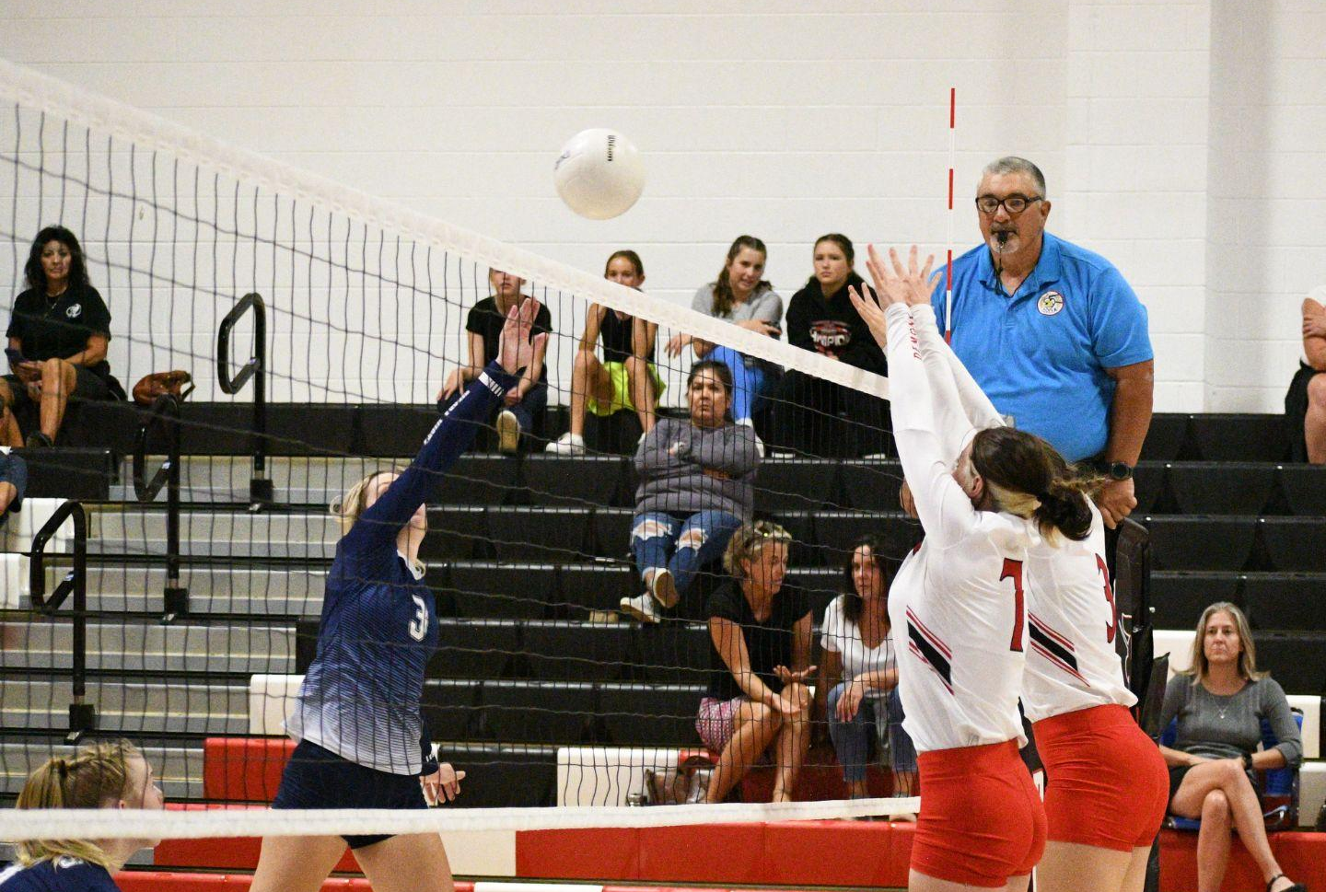
Officials Needed
If you have any interest - Let ADs know!
Game Cancellations are possible
Please treat our officials with respect and thank them if you get the chance. Keep it positive or don’t say anything at all
Communicate in-game frustrations with Coach & AD
  Postseason Officials Ranking/Feedback or CHSAA communication

Slide 16
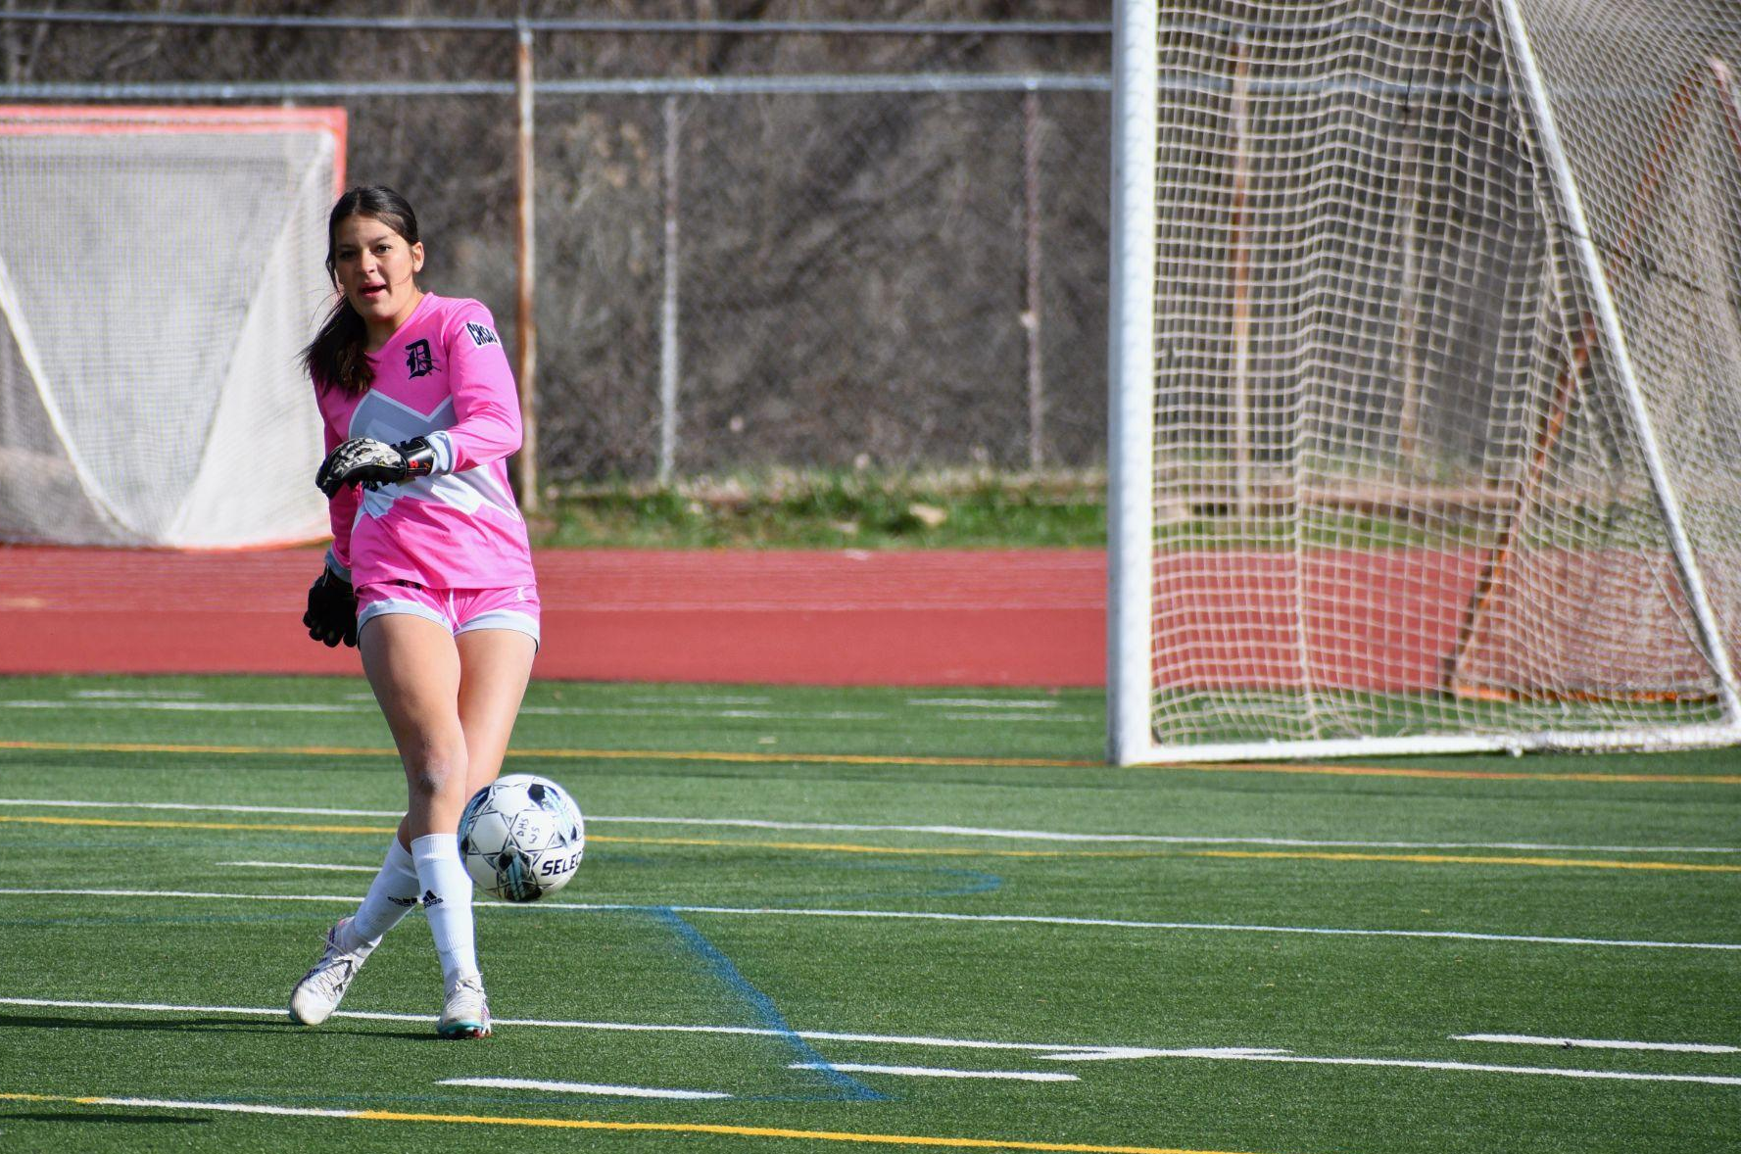
Chain of Command
Start with your student athlete
Position coach
Head coach
Athletic Director – Brett Sniffin
Dist AD – Ryan Knorr
Principal – Jon Hoerl
Superintendent - Karen Cheser

Slide 17
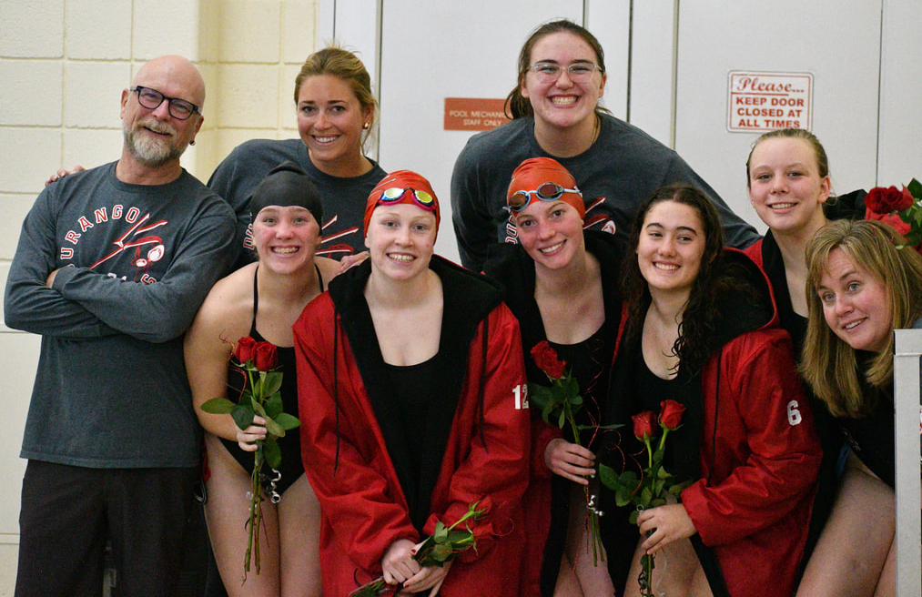
Playing Time/Team Placement
Up to the coaching staff - ADs will not meet with parents regarding playing time/level placement unless… The player has spoken to coach; Parent has spoken to coach
EMPOWER your STUDENTS
Communicate skills/abilities & areas to improve to get to their desired level
Coaches meet with students who are cut, make time for students/parents who want clarification
Varsity Letters - team specific criteria - generally, active during 75% of varsity competition; ends in good standing; postseason participation

Slide 18
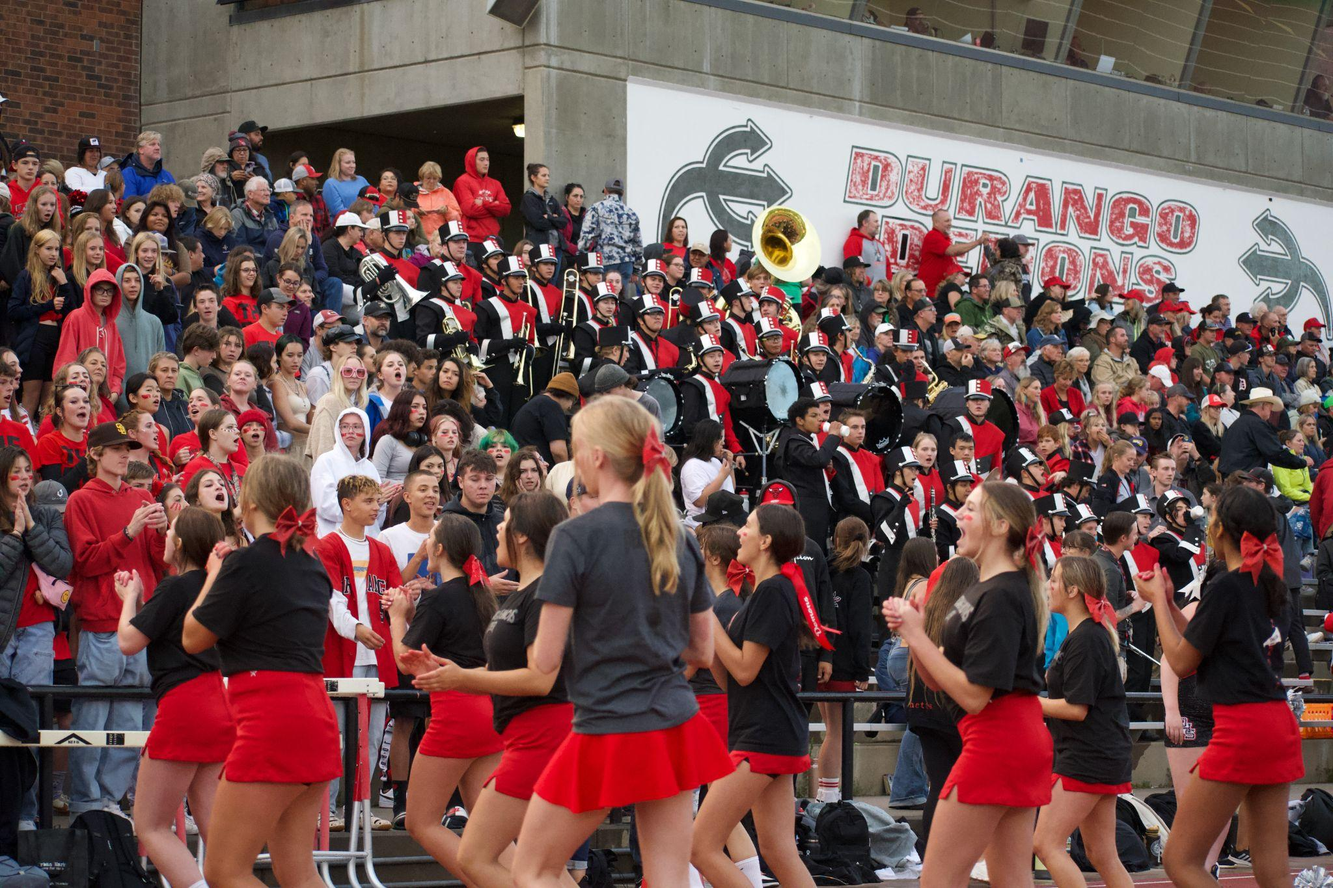
Stadium & Gym Game Day Expectations
Game Day Info Shared with coaches to pass along to parents
Gate Fees - Adults $7; DHS Students $1; Military/Senior Citizens, other students $5; 7-younger free
Season Pass available for all regular season games $85
Entrance for Stadium through the building - no side gate access
Bag Search

Slide 19
Attendance at Practice & Cuts
Practice is required to be a part of the team
High Expectations for our athletes – time management is a life-skill
Early communication from the student to coaches
Check sport specific handbooks
Club sport and in-season agreements - season requires >75% attendance - must sign CHSAA paperwork before games begin
Volleyball, Basketball, Baseball, B&G Soccer will have tryouts this year, cuts are possible

Slide 20
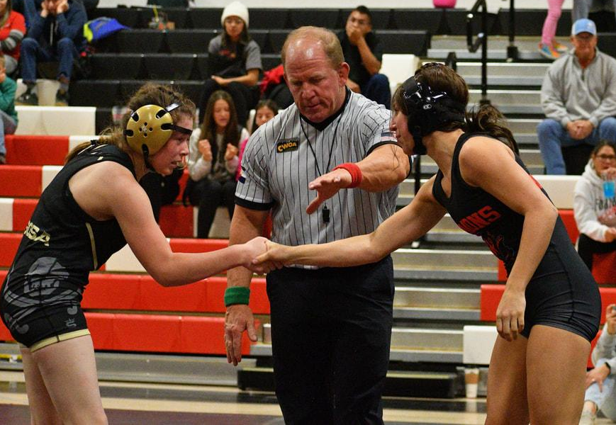
Travel
High expectations of students while traveling - coaches have a checklist for hotel supervision and protocols; searching bags, bed checks - CONSEQUENCES if handbook/code of conduct is broken while on the road
Contacting local police & parent/guardian responsibility to pick the student up immediately
Parent Transportation waiver- or parents sign out with the coach after the competition

Slide 21
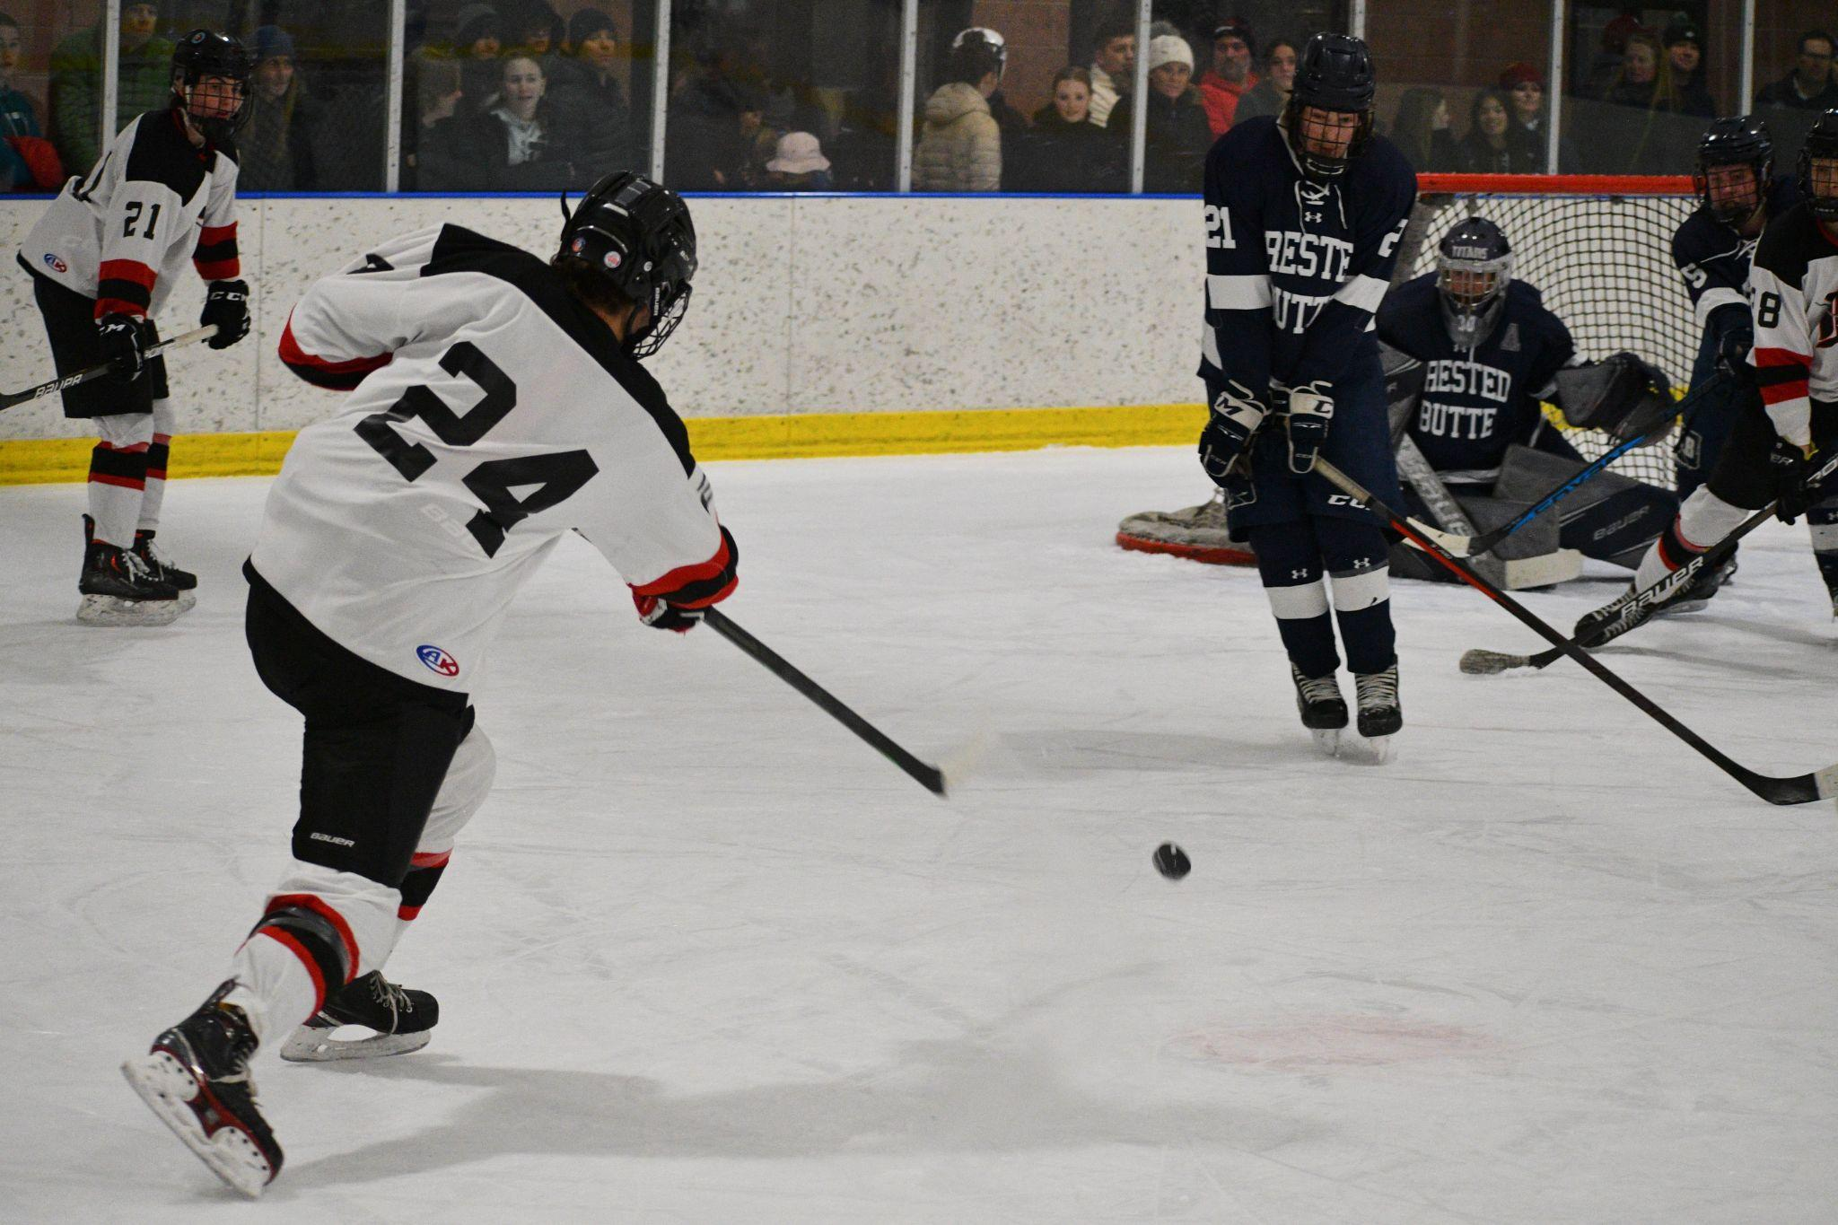
Weekly Communications/Parent Meeting
Coaches host a pre-season meeting
Team expectations/Handbook
Methods of communications explained
Answer questions and concerns
Weekly communication during season
NO SOCIAL MEDIA TEAM COMMUNICATION

Slide 22
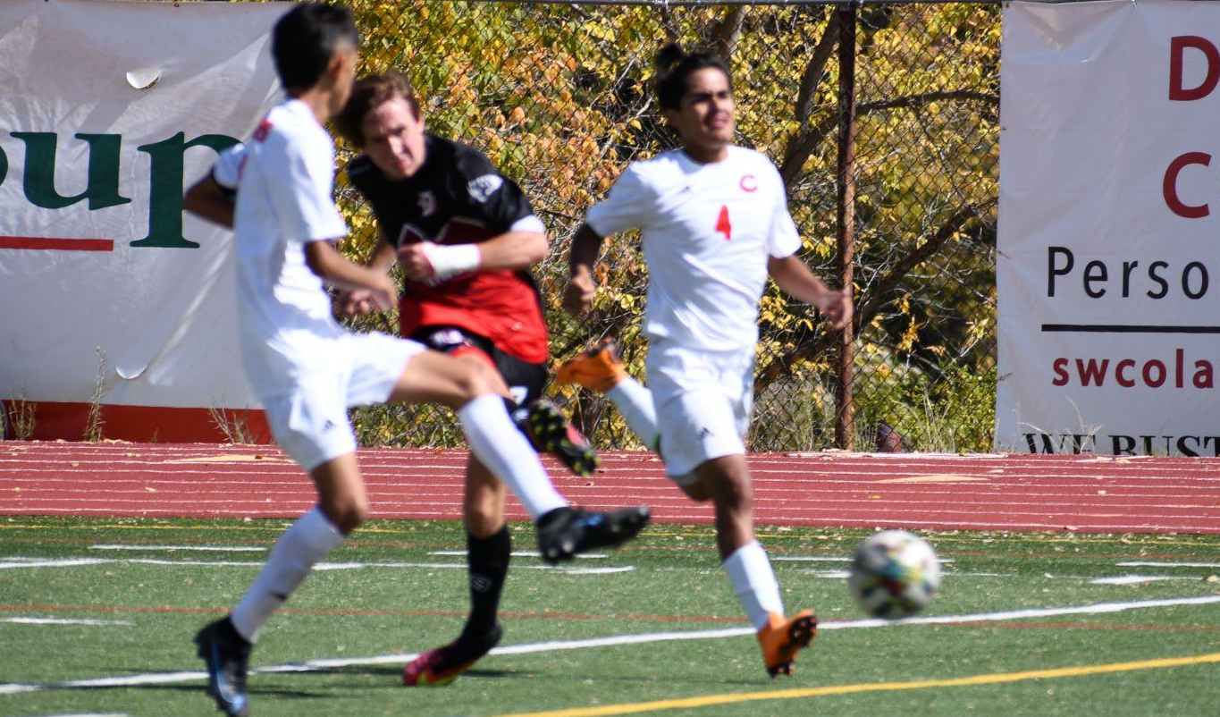
Budget
District budget covers transportation, coach stipends, payroll taxes, fees, officials, uniforms, ATs, facilities…
Fundraising covers all items that students keep – gear, food, awards, specialist coaches

Slide 23
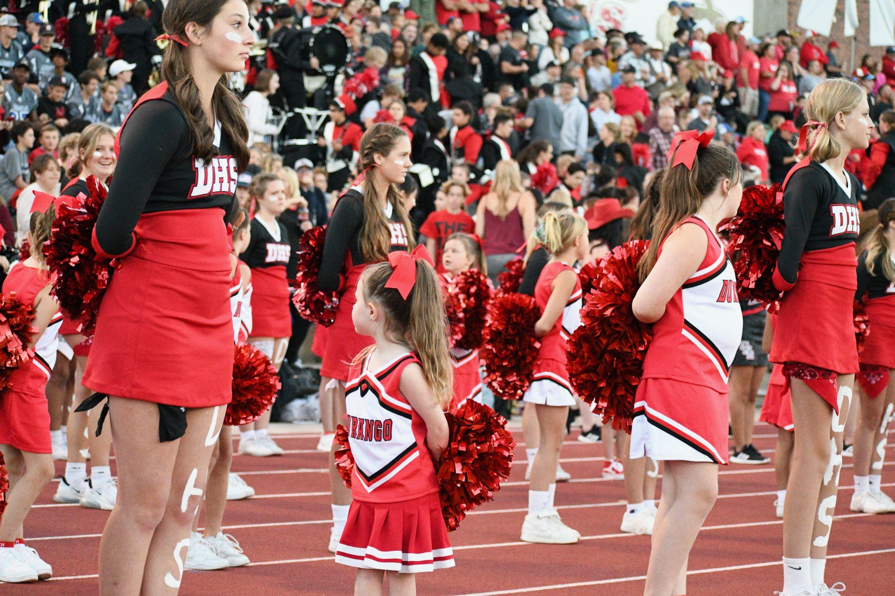
Parent Support
Assist in meals, logistics and communication
Proactive communication - check IC Often!
Lower Level game workers will not be supplied - happy to train parents on scoreboard, music, etc
Booster club: boosterdhs@gmail.com
Let us know if you’d like to help out!

Slide 24
College Corner
GPA & Character Matters
Click here for more resources - NCAA links & NAIA on playing at the next level
Signing at the next level? Let us know!

Slide 25
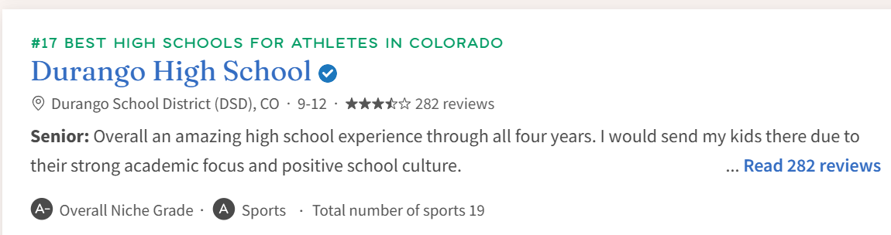
What’s Next for DHS Athletics?
Celebrations - #17 in the state: USA TODAY; Unified, Proud of the new gym, weight room, Video board, Softball/Baseball cages & upgrades
Turf Replacement Summer 2027
Coffee with Knorr - Continued transparency and communication
Streamlining our systems

Slide 26
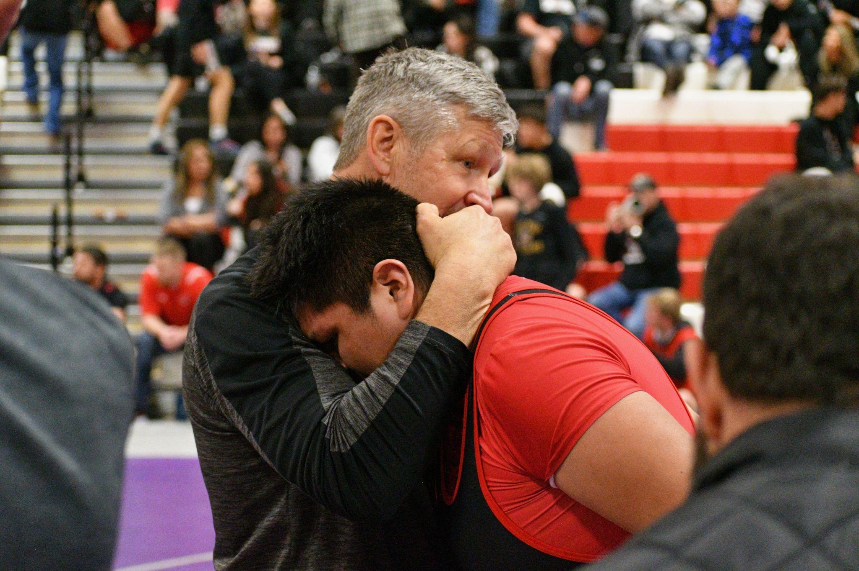
Why Athletics?
How do you measure success?
Who made a difference in my life? How?
WE’RE HERE TO HELP AND NAVIGATE AND SUPPORT!
THANK YOU for your Support - Help - commitment!

